Slide 1

IET 105 Fall 2024
Project Presentation
Student Name | ID

Slide 2
Outline
The following are the objectives for the project:
To learn proper layout design for manufactuting and production facilities by developing a layout for a fictitious bevel and inline motor design company
To understand how to follow specifications for machinery during layout design
To ensure efficient operations and materials flow during layout design.
This presentation will begin with an introduction of the project before discussing it in detail.

Slide 3
Introduction
Kuwait Motor Design, a bevel and inline motor production company, are investing in a new production hall to expand production.
The production hall is required to have two production lines, one for the KMD inline motor and the other for their bevel motor
They contracted the help of our group to design a proper layout that meets criteria, including:
Efficient flow
Meets safety standards
All employee requirements are met
Electricity and aeration needs are met

Slide 4
Project Deliverable 3
The most outstanding lesson we learned from this project was how to ensure efficient flow in a production hall during layout design
For instance, the busiest machine that requires full time operation, the CNC lathe, was placed in a corner to ensure there was uninterrupted access
The gearbox assembly line was aligned with the CNC machine to ensure proximity to machined parts for smooth process flow
Additionally, the electric motor cell was placed as close to the center of the layout as possible since it connects upstream and downstream processes
Finally, the two final assembly lines are placed near the exit to make moving complete goods outside easier.

Slide 5
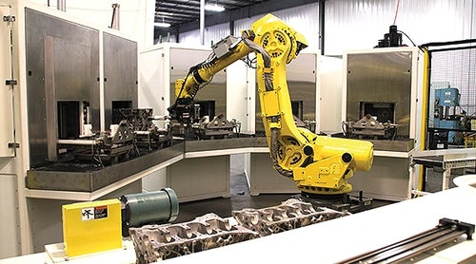
Project Deliverable 3
From the project, we also learned to cater to safety requirements, not only for people in the facility but also for other equipment
For instance, we left walkways of 1.2m next to every machine to ensure all personnel remain safe
Additionally, we isolated the aluminum casting cell to the left of the steel casing to ensure safety of persinnel. Leaving specifed spacing around it also ensured it didn't affect the operations of the gearbox assembly line.

Slide 6
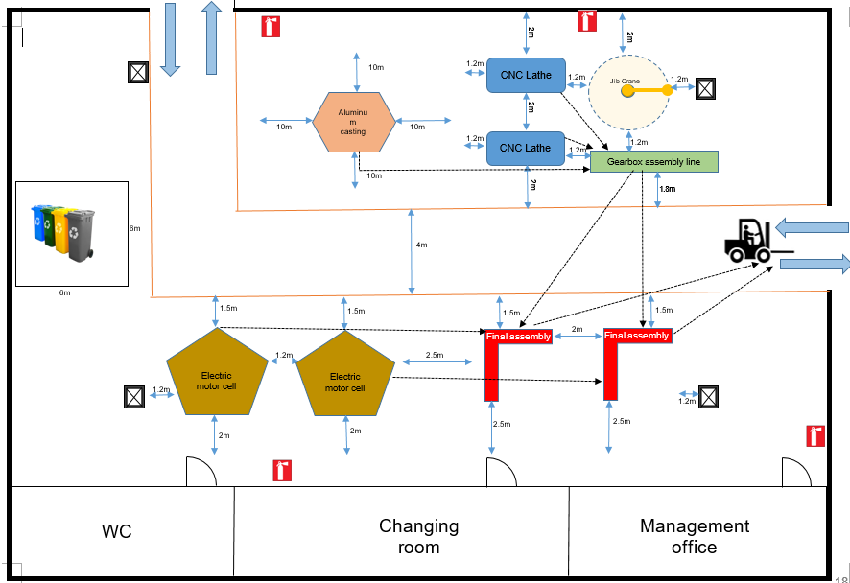
Project Deliverable 3 – Layout

Slide 7
Conclusion and Future works
In sum, our group worked together and managed to create a layout design for KMD that includes all the required machinery, operations, and follows the specifications provided, with a clear focus on efficient flow, safety standards, employee requirements, and the proper infrastructure for both electrical and air needs.
Working on this case, which is similar to a real life situation will help ensure we can design proper layouts for other production companies in the near future where we'll be working as engineeers.
We developed our teamwork skills, all while learning to interpret and follow requirement specifications. We experienced difficulty with team coordination while deciding what was fit, but managed to overcome the challenge by listening to each other objectively and deciding the best way to undertake the project.

